Slide 1
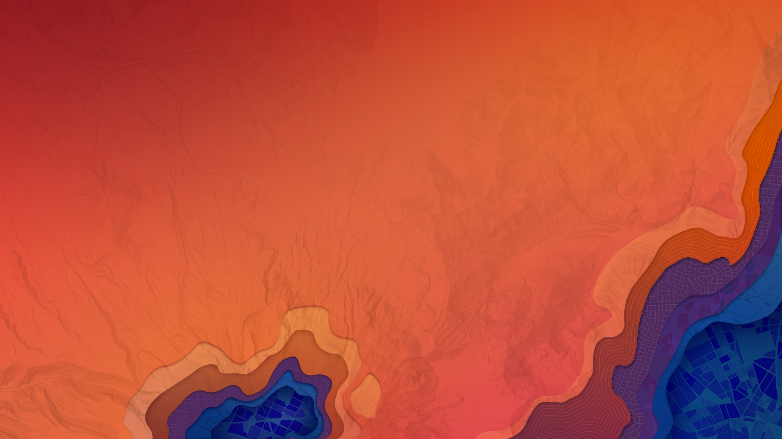


Getting Started with ArcGIS API for JavaScript
Kelly Hutchins
Nick Senger
Notes:
Kelly starts

Slide 2

Overview
Setting up dev environment
Debugging tips and tricks
Tour of the SDK
Build an app
Create map
Add layer
Make it interactive
Add widgets

Slide 3

Focusing on version 4.0 for this presentation
Concepts are similar between 3.x and 4.0
Version 3.x UC 2015 presentation and demos are available
TODO ADD LINK TO GITHUB REPO WITH SLIDES AND DEMOS

Slide 4
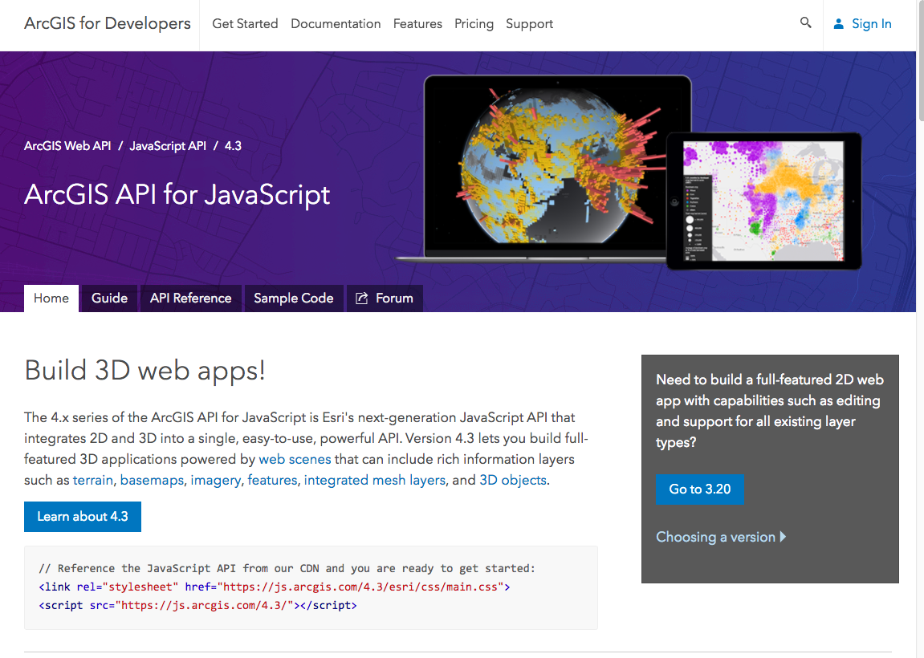
Where to begin?
https://developers.arcgis.com/javascript
Notes:
Take a quick tour of the API and point out important help topics and useful samples

Slide 5
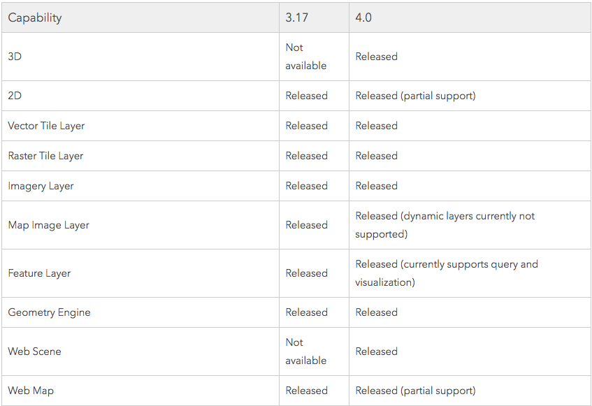
Choosing a version
https://developers.arcgis.com/javascript/latest/guide/choose-version/index.html
Notes:
Click image to navigate to help topic discussing which capabilities are available in 4.x

Slide 6
Developer Setup
Choose an IDE
Code assist
Helpful tools
Notes:
Lots of IDE options available from bare-bones tools like Notepad++ or Sublime text to full featured tools like Web Storm. Some options are Visual Studio Code, Sublime, Atom, Brackets and more.
Most of these environments have add-ins available to help simplify common tasks like working with gihtub, prettifying your code, linting and much more.
Github repo for JSAPI point out typescript and jshint
https://github.com/Esri/jsapi-resources
Nick talks a bit about tslint

Slide 7
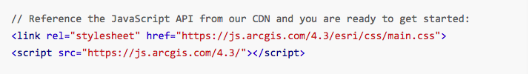
Get the API
CDN
Custom builds
Download API
https://developers.arcgis.com/javascript/latest/guide/using-bower/index.html
Notes:
Multiple ways to access the api. The most popular way is to access the api via the hosted CDN. Bower is a good option if you’d like to generate a custom build of the API and finally the downloaded version is a good option if you’d need to host the api yourself – for example if you are working in a restricted environment with no internet access.

Slide 8

CSS
Main.css
View.css
Custom css (SASS)
https://developers.arcgis.com/javascript/latest/guide/styling/index.html
Notes:
Several options for adding necessary CSS to your app.
The main.css contains all the css for everything in the JSAPI. Simple to use since everything is in one css file but could be extra overhead if you are only making a simple app.
For simple apps use view.css which contains css for basic map with default widgets.
Finally for the most control you can create your own custom css build. Check out the help topic on custom css for details.

Slide 9
JSAPI Resources
Collection of resources to aid development in the JSAPI
Some of these include:
JSHint file
Helps to detect errors and potential problems in code
Typescript definition file
Provides code assist in some IDE’s such as Visual Studio Code
Build tools, e.g. Bower for custom builds of the API
Callback page for popups using OAuth2 for security
https://github.com/Esri/jsapi-resources
Notes:
We provide some resources to help make developing a bit easier. Most of these resources are what are developers on the API use themselves.
For example, we provide a jshint file that you can download and use to help detect errors or potential problems in your code. There may be certain warnings that you receive but do not care about, you can open this file and modify it to your specific needs.
We also provide a TypeScript definition file. This file provides code assist in some IDE’s. One thing to point out is that many IDE’s that may not specifically support working with TS files still have their own form of code assistance or ’smart’ typing.
There are build tools provided that help to create your own custom local build of the JSAPI using Bower.
And lastly, we provide a sample callback page which can be downloaded and used if working with Oauth for security. This page would be needed if used with an Oauth signin popup page.

Slide 10

Build first app

Slide 11
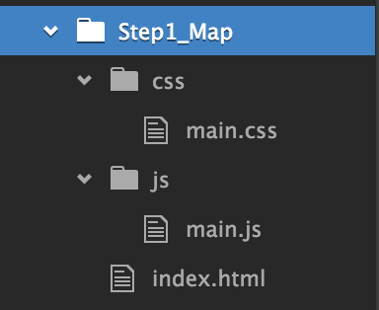
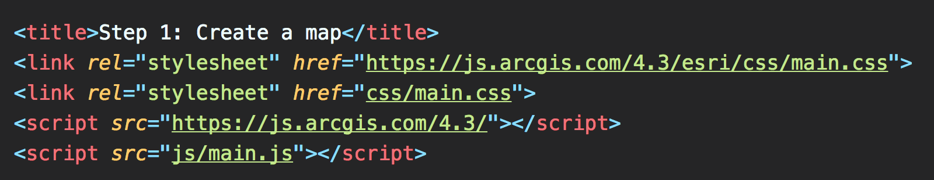
First Steps
Plan application structure
Demo structure
Separate css, html , js
Reference JSAPI, CSS etc.

Slide 12
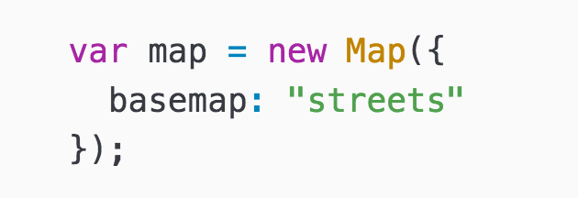
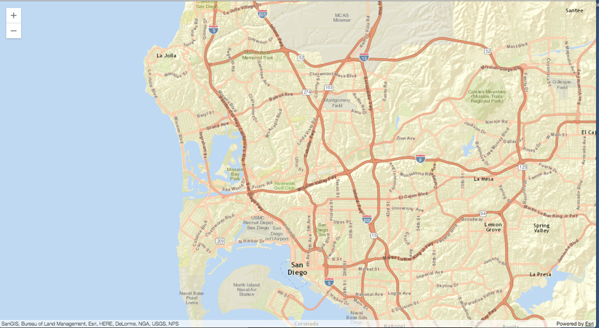
Make a map
https://developers.arcgis.com/javascript/latest/api-reference/esri-Map.html
Notes:
During this session we’ll walk you through the process of creating a sample app and you’ll learn how to add data, make the map interactive work with events and widgets, symbolize your features and more.
Point out Map class in help and show module you need to load
Look at constructor options
Create simple map in our code file

Slide 13
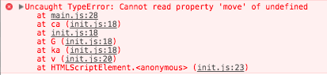
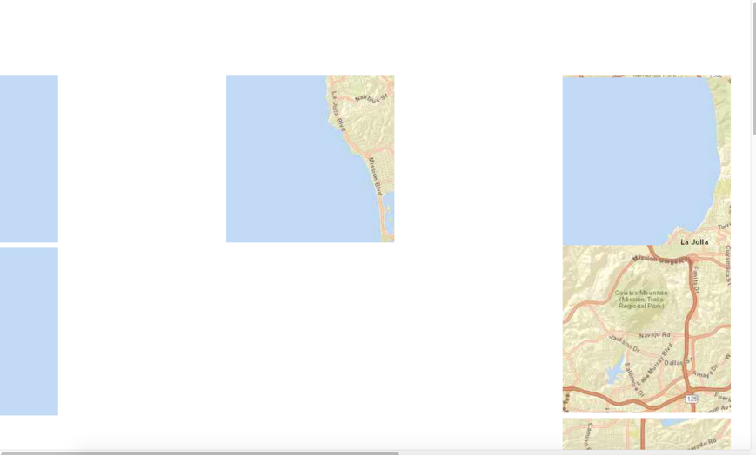
Debugging Tips
Module Order | Missing CSS
Order matters TypeScript helps | Unstyled widgets Scrambled tiles
Notes:
Show a couple things that can happen when running your application, missing tiles, modules out of order, etc.
Possibly open console tab and show error message.

Slide 14
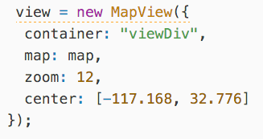
Map View
https://developers.arcgis.com/javascript/latest/api-reference/esri-views-View.html
Notes:
Look at map view and explain relationship between map and map view. Point out the same logic for scene and scene view.
Views are used specifically to visualize the data within your map or scene. A map contains the actual data or layers to display, whereas the view handles displaying this data. How this data is visualized, or displayed, varies depending on whether you're working in 2D or 3D. The view has a reference to the map, e.g. view.map. But the map does not have a reference to the view. It is important to note that a single map can be consumed by multiple views.
Here's another way to think of this: the map describes the basemap and features in the world, whereas the view is the window to that map that allows it to be viewed.
Kelly does JS demo

Slide 15

Demo
Get started with map
Notes:
Nick does ts example

Slide 16
Add data to map
Notes:
Nick presents about adding data to map

Slide 17
Add data
Many layer types
Feature layer
Map image layer
Tile Layer
Vector Tile Layer
…. and more

Slide 18
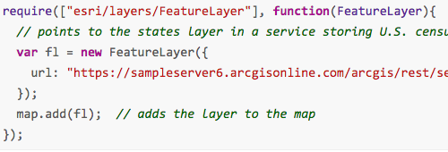
Layer coding pattern
Load module
Create layer
Set properties
Add to map (or scene)
Notes:
Regardless of what type of layer you are using, the basic coding pattern remains the same.
First, Load the module. If you aren’t sure exactly where it resides, go to the API reference to see it’s location
Second, create the actual layer, e.g. “New ….layer”
Third, specify any properties for that layer, for example do you want to set
Lastly, add the layer to the map (or scene)

Slide 19
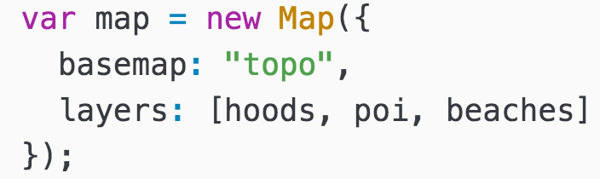
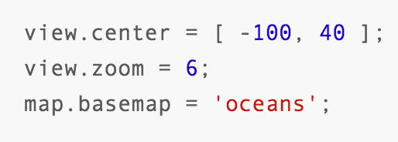
Working with properties
Set properties in constructor
Or directly on the instance
https://developers.arcgis.com/javascript/latest/guide/working-with-props/index.html
Notes:
Can now watch for property changes and act upon them. This is much more fine-grained than simply listening for some events to happen.

Slide 20
Working with properties – continued
Watch for property changes
Use esri/core/watchUtils to aid in watching property changes
Once
When false
When true
https://developers.arcgis.com/javascript/latest/api-reference/esri-core-watchUtils.html

Slide 21
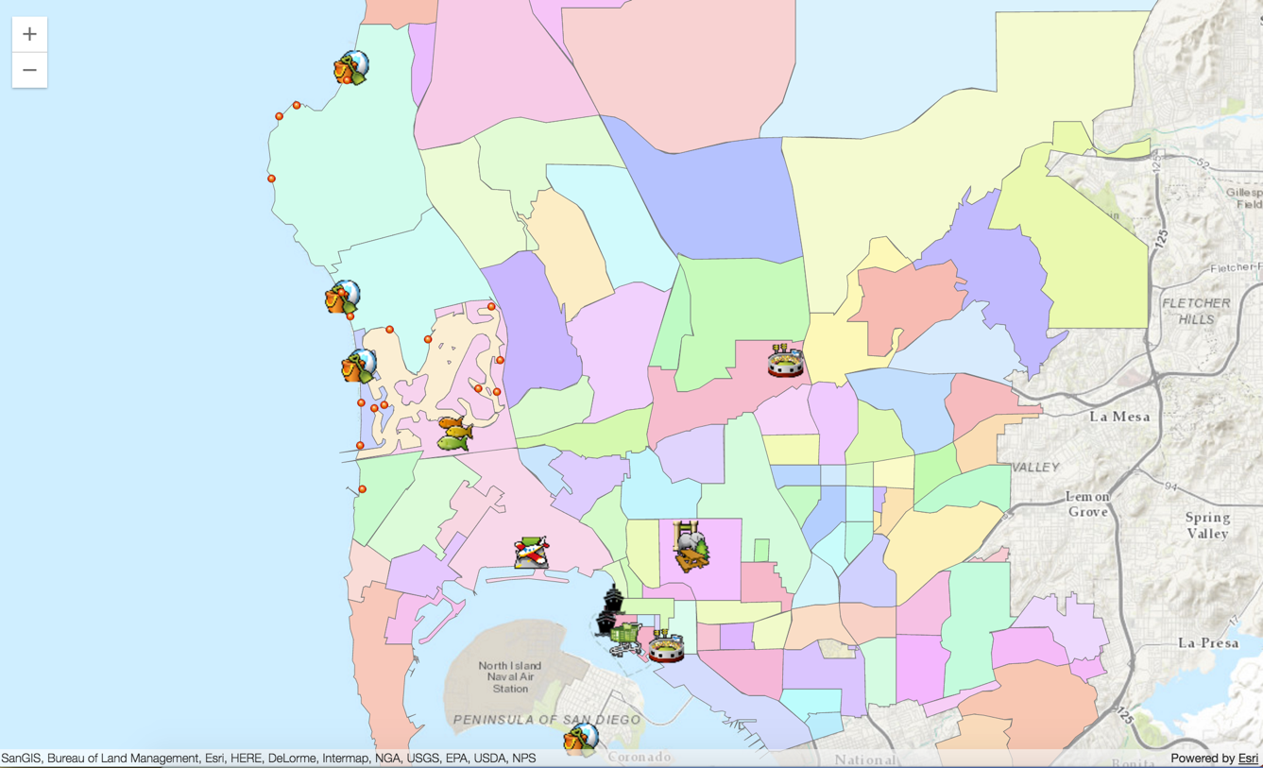
Demo
Add layer to app
Notes:
Nick demos adding layer to map

Slide 22
Symbolize data
Notes:
Nick presents symbolize data section

Slide 23
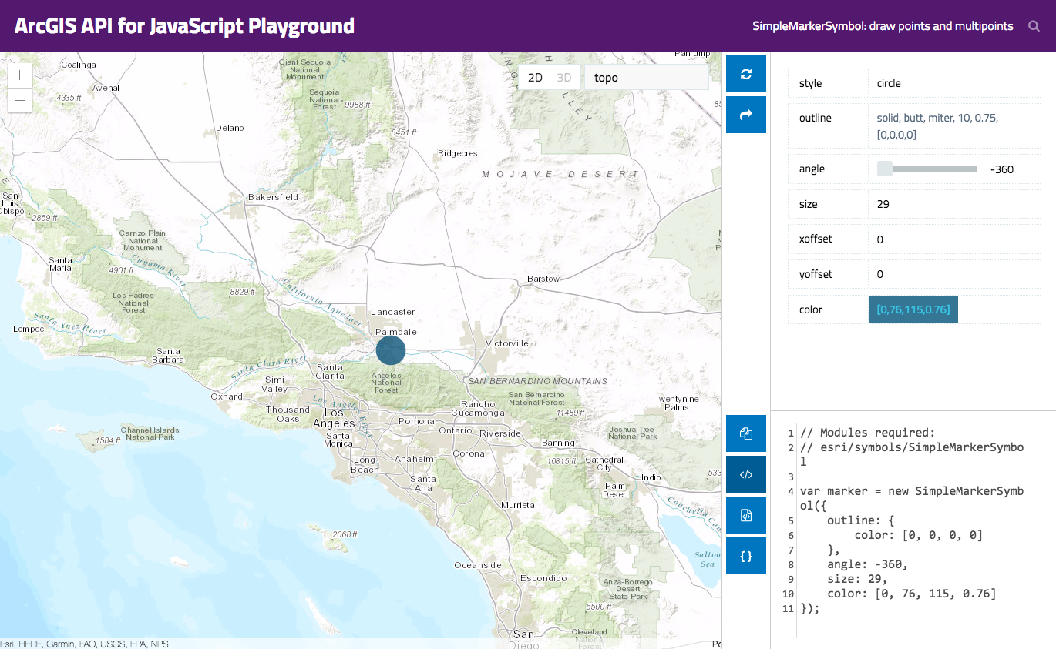
Symbols
Define symbols used to represent your data
Many types
SimpleMarkerSymbol
PictureMarkerSymbol
SimpleLineSymbol
TextSymbol
….. and more
https://developers.arcgis.com/javascript/latest/sample-code/playground/live/index.html
Notes:
Show how you can generate symbol code using the symbol playground

Slide 24
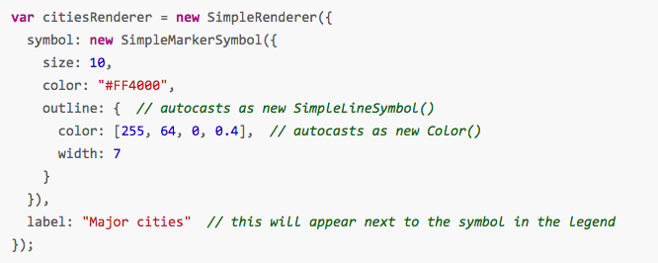
Renderers
Define a set of symbols and rules for drawing the layer
Apply renderer to the layer
Notes:
Renderers help specify how you wish to represent the layer.
Libraries that help display information on the map, you apply the renderer once, no matter the amount of features. The renderer will loop through all the features and apply and symbology to them.
There are various types, such as uniquevaluerenderer, classbreaks, simplerender and more

Slide 25
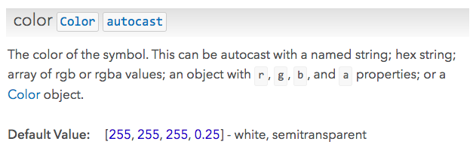
Autocasting
Use a property without having to import module
Look for autocast label
https://developers.arcgis.com/javascript/latest/guide/autocasting/index.html

Slide 26
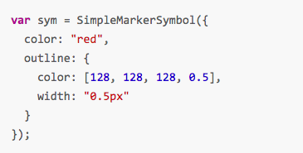
Autocast code sample
Notes:
Look at how you can autocast color and outline instead of new Color and new SimpleLineSymbol

Slide 27
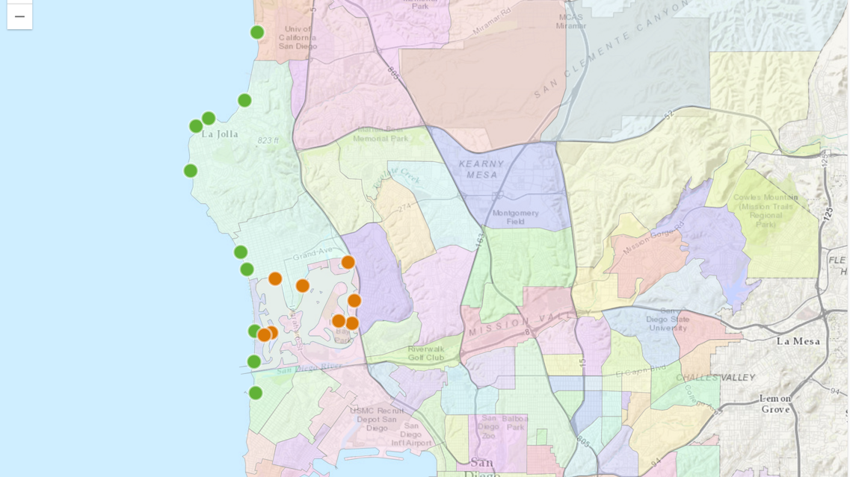
Demo
Apply renderer to layer
Notes:
Nick demos adding renderer

Slide 28
Make app interactive
Notes:
Kelly does popup section

Slide 29
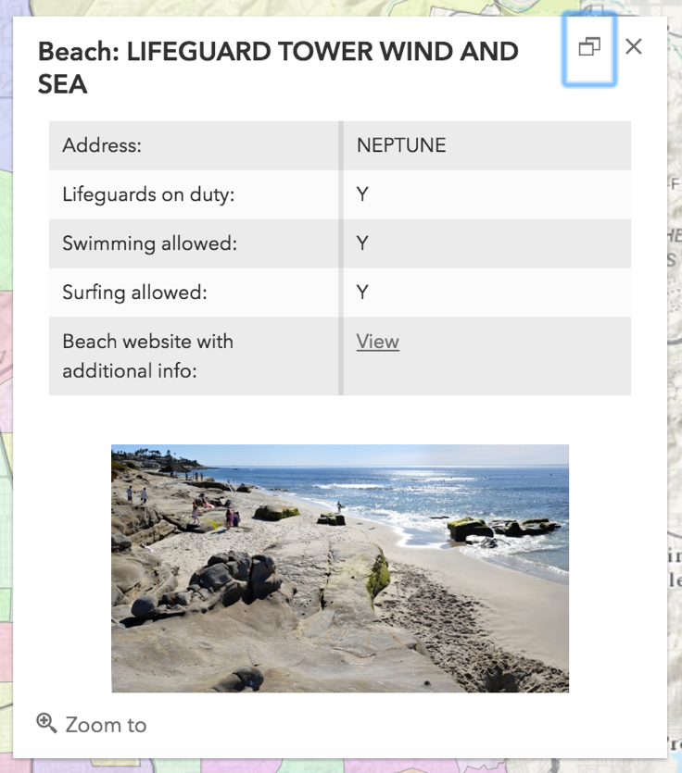
Add interactivity : Popups
Responsive
Details about
Clicked location
Feature
Search results
Customizable
https://developers.arcgis.com/javascript/latest/api-reference/esri-widgets-Popup.html
Notes:
Add popups to simple app – popup template for feature layer
Show a few help samples too including one that shows how to add a custom action.

Slide 30
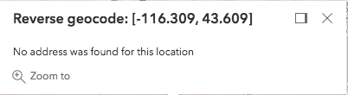
Popup components
All views have default popup
Define title and content
Popup
Popup Template
Custom actions
Notes:
Link to elevation profile sample

Slide 31
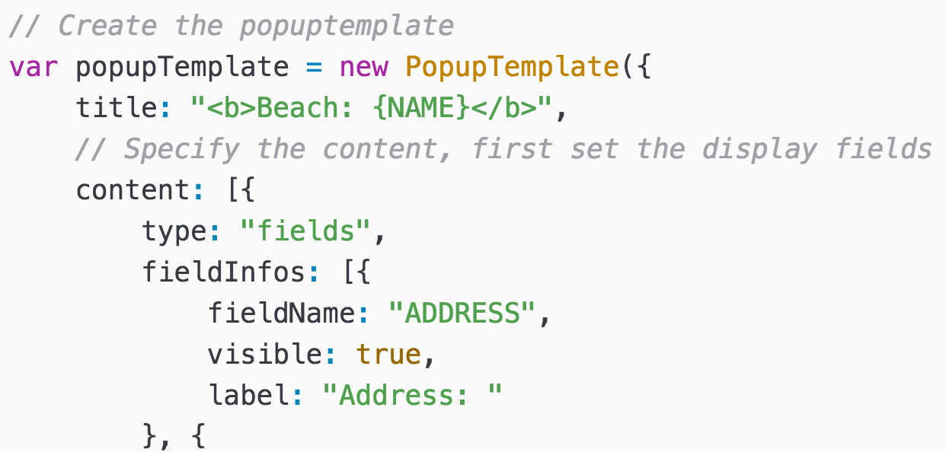
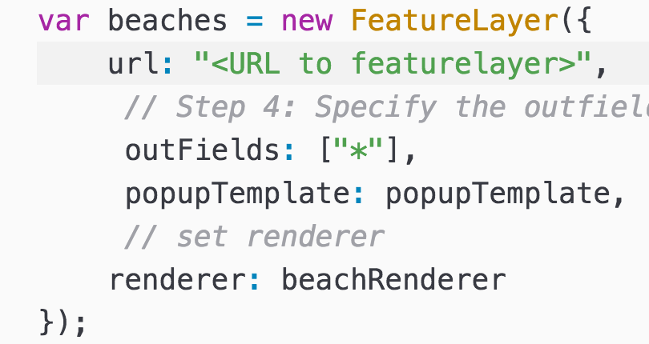
Popup Template
Define content in PopupTemplate
Associate template with layer
https://developers.arcgis.com/javascript/latest/api-reference/esri-PopupTemplate.html

Slide 32
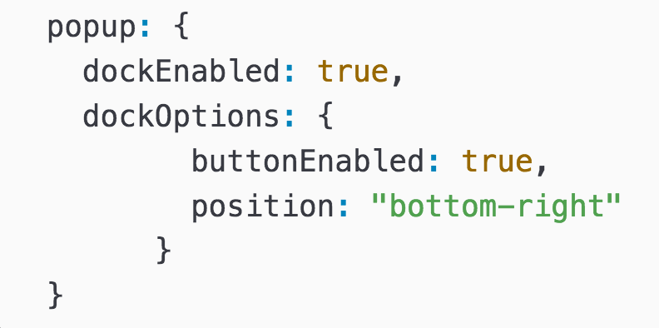
Dockable
Define dock position
bottom-right
top-right
bottom-left
top-left
bottom-center
top-center
https://developers.arcgis.com/javascript/latest/sample-code/popup-docking-position/index.html

Slide 33
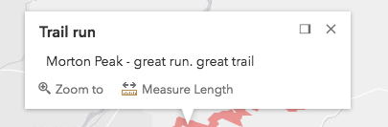
Popup: Custom Actions

Slide 34
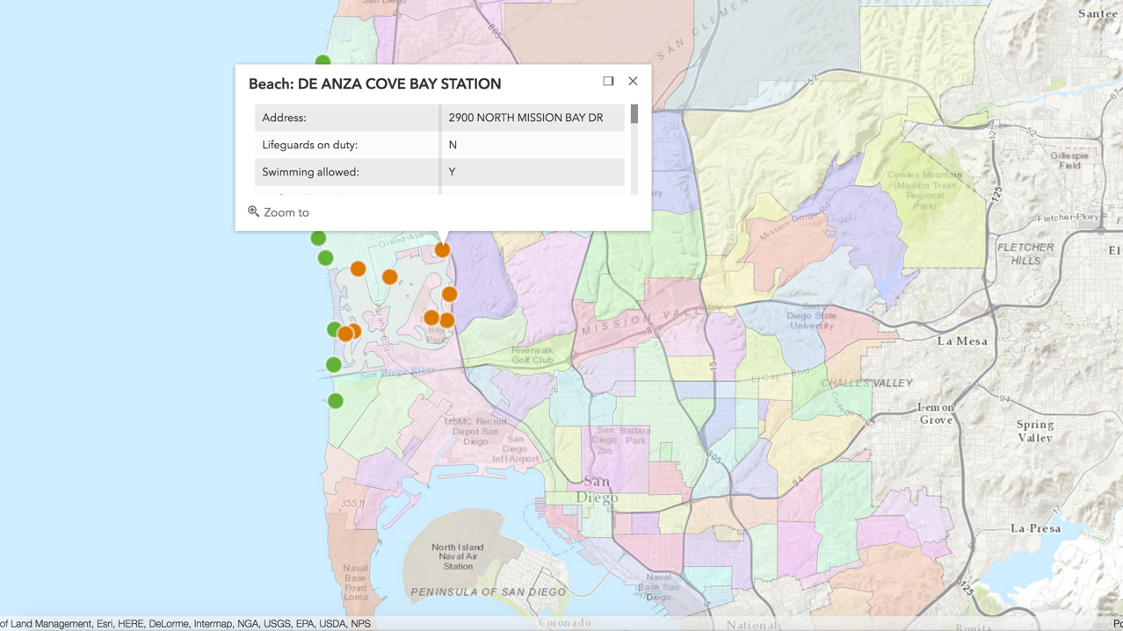
Demo
Add popups
Notes:
Kelly demos adding popup to map

Slide 35
Web maps
Notes:
Kelly demos webmaps

Slide 36
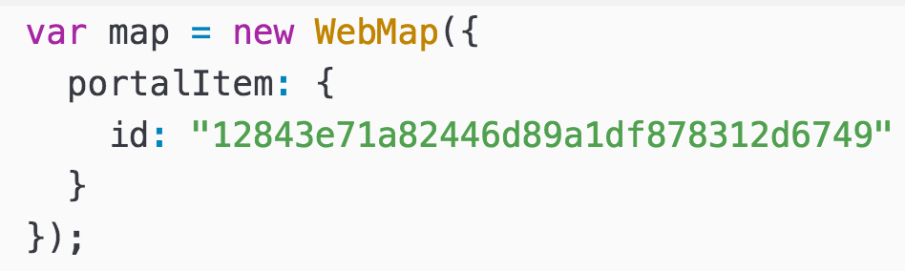
WebMap
Write less code!
Use ArcGIS Online/Portal Map Viewer to:
Specify basemap and extent
Define symbology
Create popup content
Add layers
https://developers.arcgis.com/javascript/latest/api-reference/esri-WebMap.html
Notes:
Show web app that is same look as our demo app but uses createMap so its only a few lines of code to build app instead of all the code required to create a map, add layers ,define renderer, setup popup template etc.

Slide 37
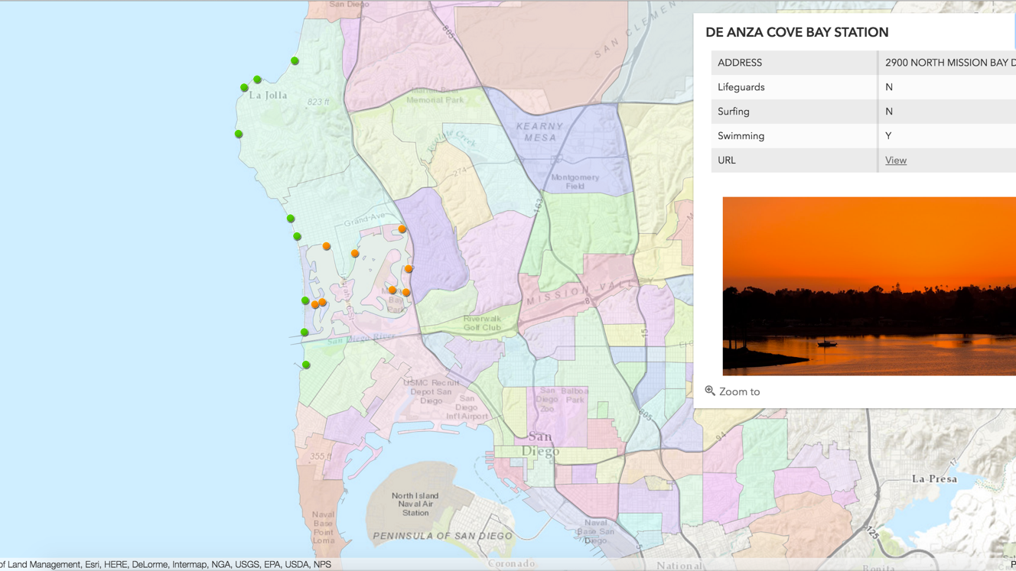
Demo
Use WebMap

Slide 38
Widgets
Notes:
Nick does widgets

Slide 39
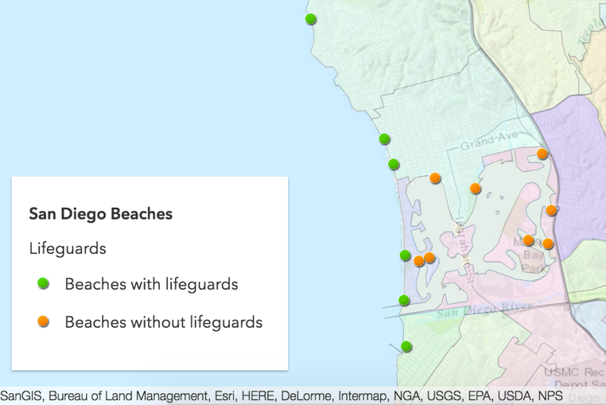
Widgets
Basemap
Compass
Home
Legend
Search
Expand
Locate
…. and more
https://developers.arcgis.com/javascript/latest/sample-code/get-started-widgets/index.html

Slide 40
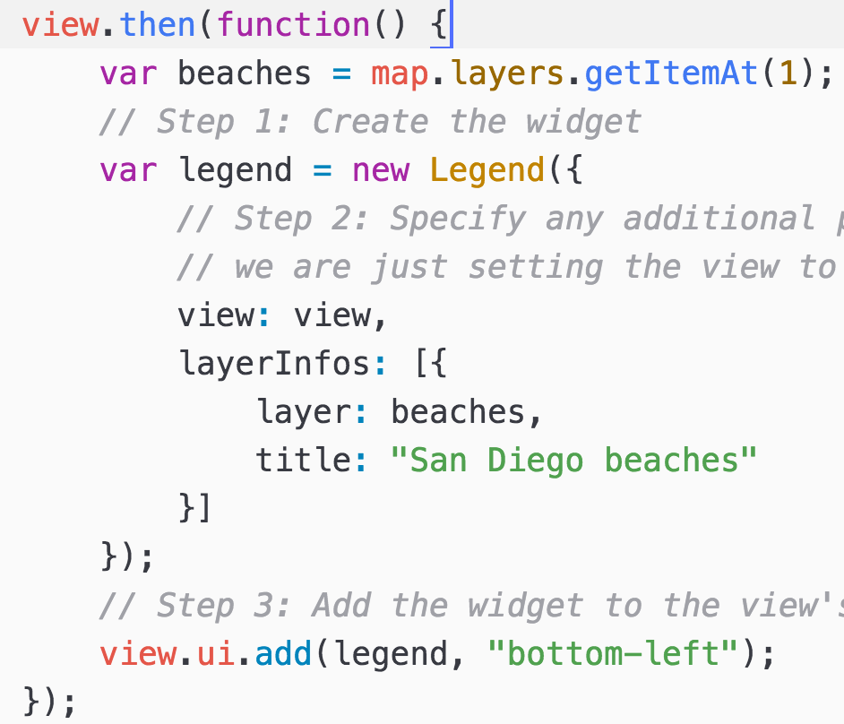
Widget coding pattern
Load module
Create widget
Set properties
Add to View’s UI

Slide 41
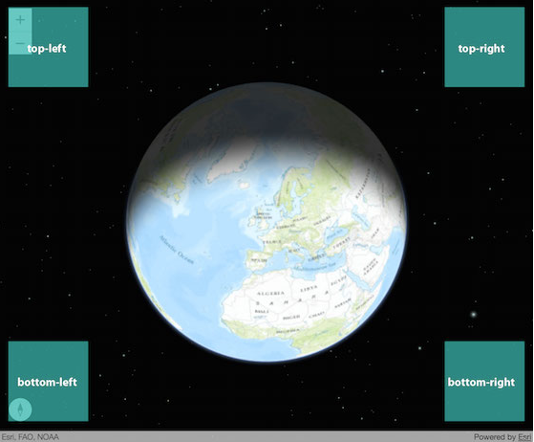
View UI
Simple process of placing widgets in app
https://developers.arcgis.com/javascript/latest/guide/view-ui/index.html

Slide 42
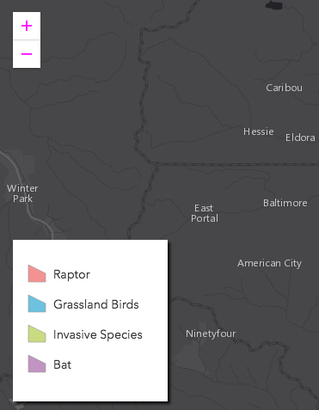
Customize widget appearance
CSS
SASS
https://developers.arcgis.com/javascript/latest/guide/styling/index.html
Notes:
Make some simple changes to widget and point out sass doc
https://developers.arcgis.com/javascript/latest/guide/styling/index.html
Do something simple like show how to change zoom icon color, hide title and add a box shadow.

Slide 43
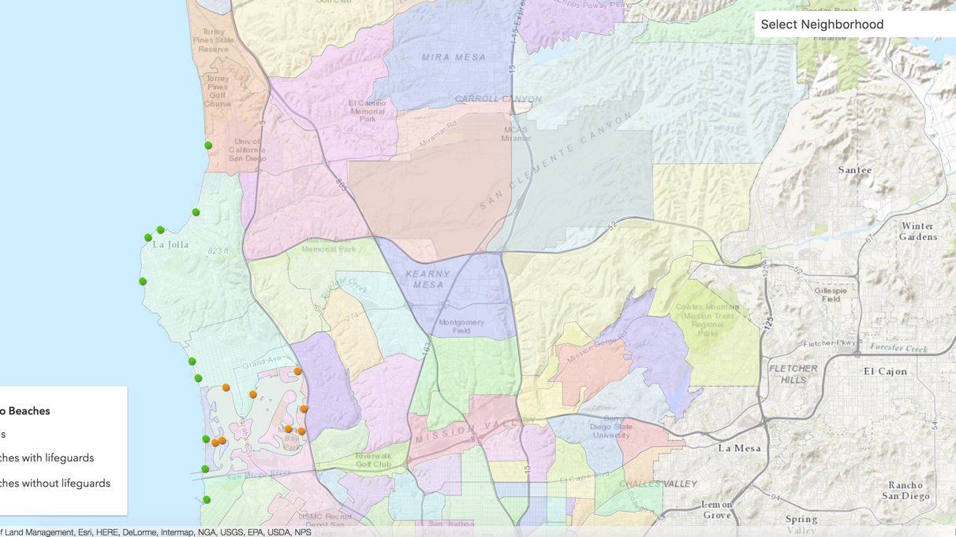
Demo
Add widget to app
Notes:
Nick demos widget example
TODO update code to put legend in expand widget

Slide 44



Slide 45
Which Font is Best For Your Presentation?
Avenir Next
If you are the sole presenter and will not distribute your PowerPoint presentation to others outside of Esri and will only be using your own Esri computer for presenting, please use the new font Avenir Next LT Pro.
See instructions on the following slide to see how to use this new font.
Arial
If you will be distributing your PowerPoint presentation to others outside of Esri, or using various computers to present please use Arial.
Using Arial gives your PowerPoint presentation the flexibility to be used by many people on various machines without the risk of font compatibility and changing the look of your layout.
Use Avenir Next if …
Sole Presenter Single computer used for presentation
Use Arial if…
Multiple Users / Presentation Distributed to others Presentation used on multiple computers

Slide 46
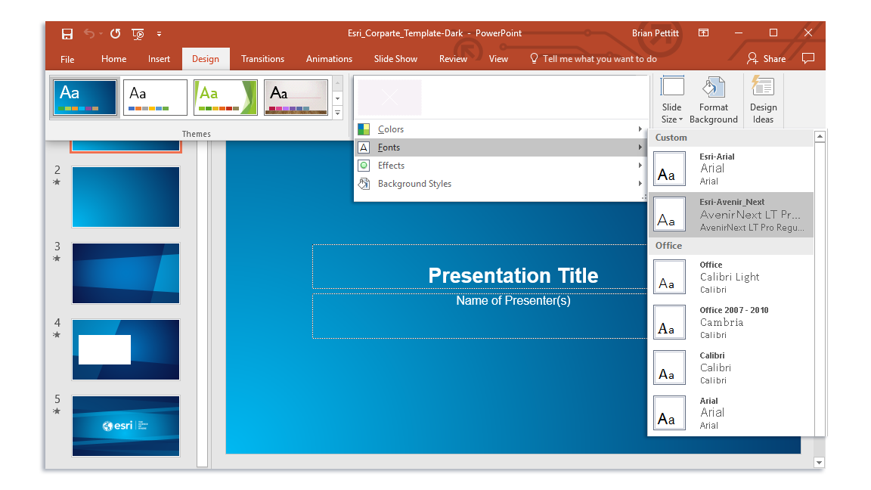
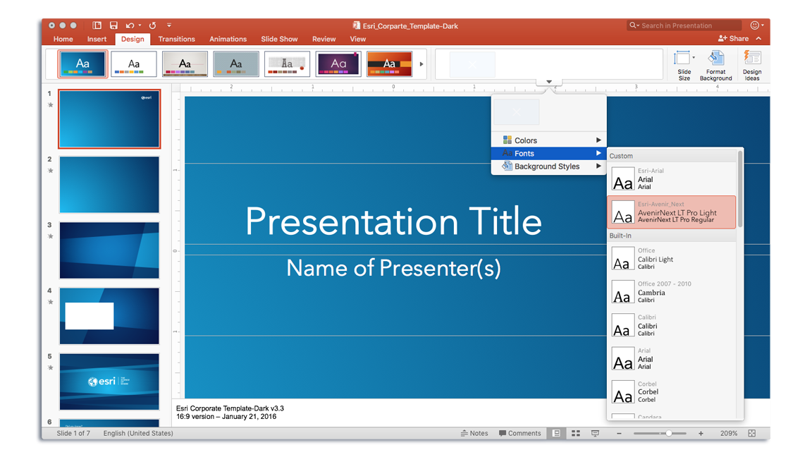
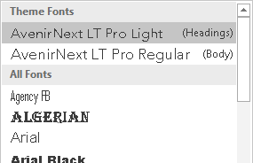
How to Change Your Theme Fonts to Avenir Next
Windows
Select: Design Variants (arrow) Fonts > Esri-Avenir Next
Mac
Select: Design Variants (arrow) Fonts > Esri-Avenir Next
What if my fonts don’t change?
If the text boxes on your slides are not using (Heading) or (Body) fonts from the Theme Fonts section, they will not update correctly. You will have to replace them manually.

Slide 47

How to Test if you’re using Avenir Next
If you have Avenir Next installed, the two Qs will match.
Q
Picture
Live Text

Slide 48
Did you know?
To quickly update any current presentation
Copy and paste your slides from your current deck into the newest template. The title and ending logo slide will update automatically.
For More Templates, Sample Files, and Icons See
https://compass.esri.com/resources/presentations/Pages/Main.aspx
Videos not working? For video in PowerPoint, animated GIF is recommended. AVI and WMV (native PC files) will work best on a PC platform. H.264 MP4 will work only on PowerPoint 2013 and later.

Slide 49
Aspect Ratio Test
If this shape does not appear as a perfect circle, adjust the aspect ratio of your display until it does.
Try the resolution 1920x1080 for 16:9 displays.

